Slide 1


Basic Details of the Team and Problem Statement
HackToFuture-2024
In Association with
Domain :
Web Development
PS Code:
WD02
Problem Statement Title:
Surplus To Serve
Team Name:
Born2Code
The Institution of Engineers (India)
Local Centre, Belagavi
Team Leader Name:
Onkar S Bevinakatti
Institute Name:
Smt. Kamala and Sri. Venkappa M. Agadi College of Engineering Technology, Lakshmeshwar – 582116.

Slide 2
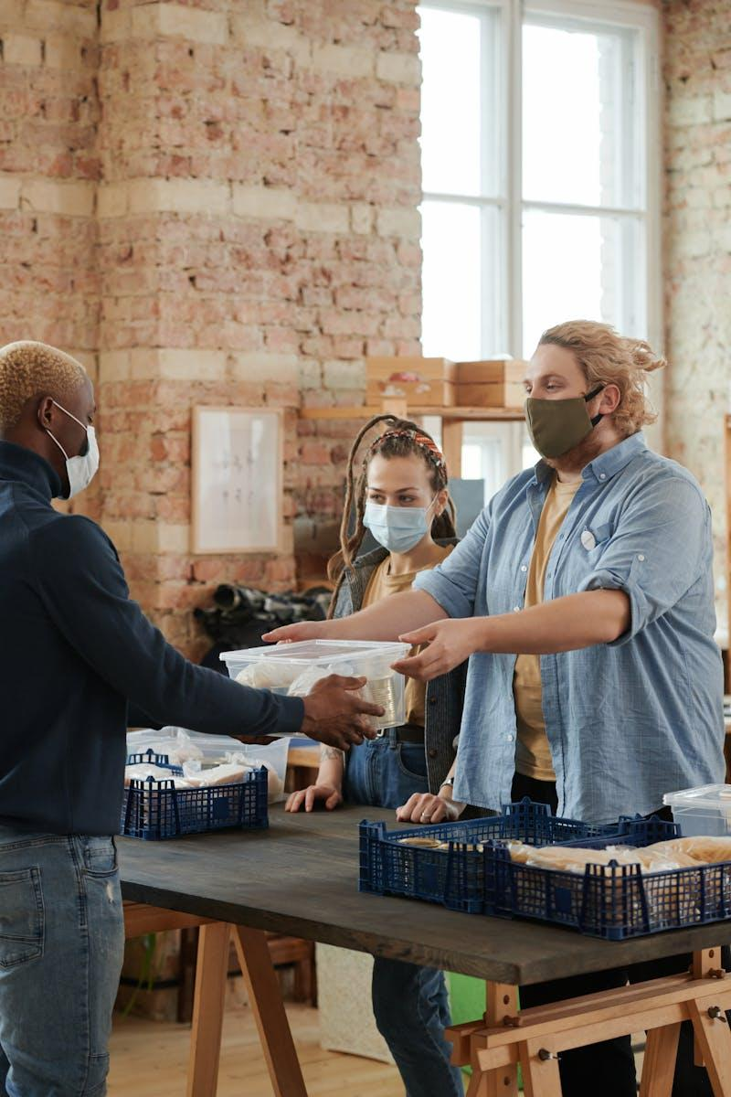
Bridging Surplus Food
NGOs and Restaurants Unite
Photo by Pexels

Slide 3
01
Introduction
Table of Contents
02
The Solution
03
How It Works
04
Key Features
05
Impact
06
User Feedback
07
Challenges
08
Future Plans
09
Conclusion
10
Q & A

Slide 4
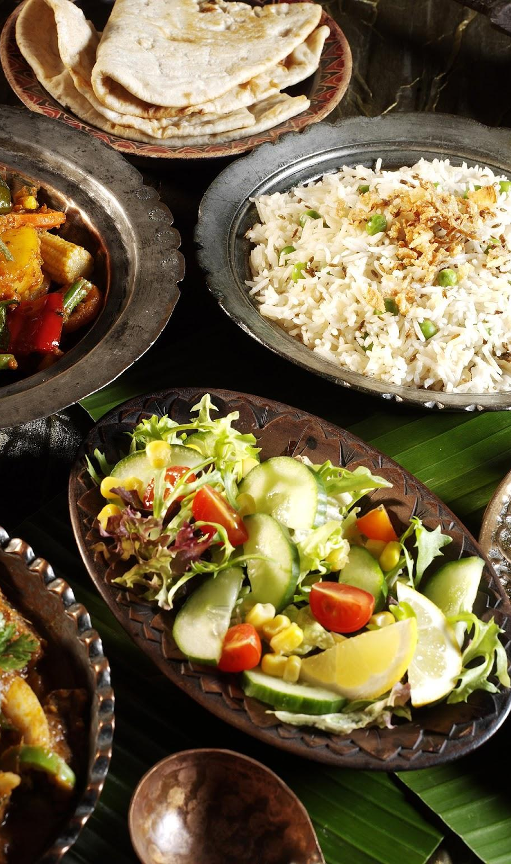
1
Introduction
The Problem
Many restaurants end up with surplus food that goes to waste every day instead of feeding the hungry.
NGOs and shelters face challenges in providing consistent and nutritious meals to those in need due to resource constraints.
There’s a significant gap in the logistics and communication between NGOs and restaurants which hinders effective food distribution.
Bridging this gap can ensure surplus food reaches hungry individuals, reducing waste and helping the community.

Slide 5
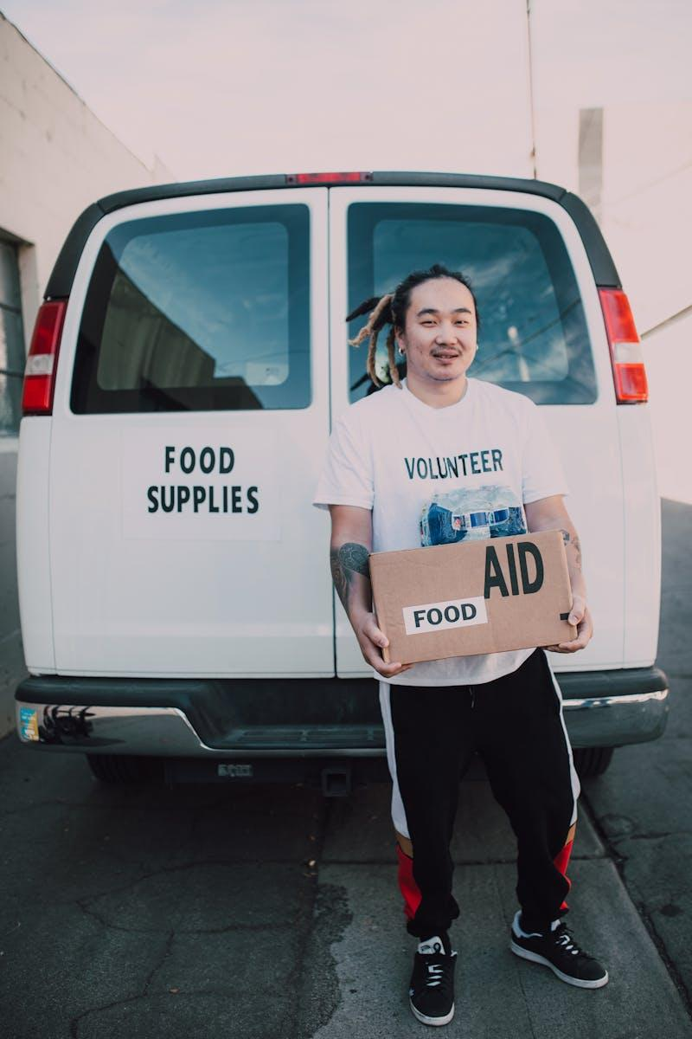
2
The Solution
Web App
Introducing a web application designed to connect restaurants with surplus food to NGOs in need of food donations.
The app provides a platform for restaurants to list available surplus food and for NGOs to claim these donations.
It facilitates real-time communication, ensuring timely and efficient food distribution where it’s most needed.
This solution aims to streamline the donation process, minimizing waste and maximizing help for the needy.

Slide 6

3
How It Works
Operational Flow
Restaurants enter the details of surplus food, specifying type, quantity, and pick-up/Delivery times on the application.
NGOs and shelters browse available food listings, selecting items they need and arranging pick-up details.
The app tracks food donations and facilitates connections through notifications and messaging features.
This seamless process ensures the food gets to those who need it quickly and efficiently, reducing spoilage and waste.

Slide 7
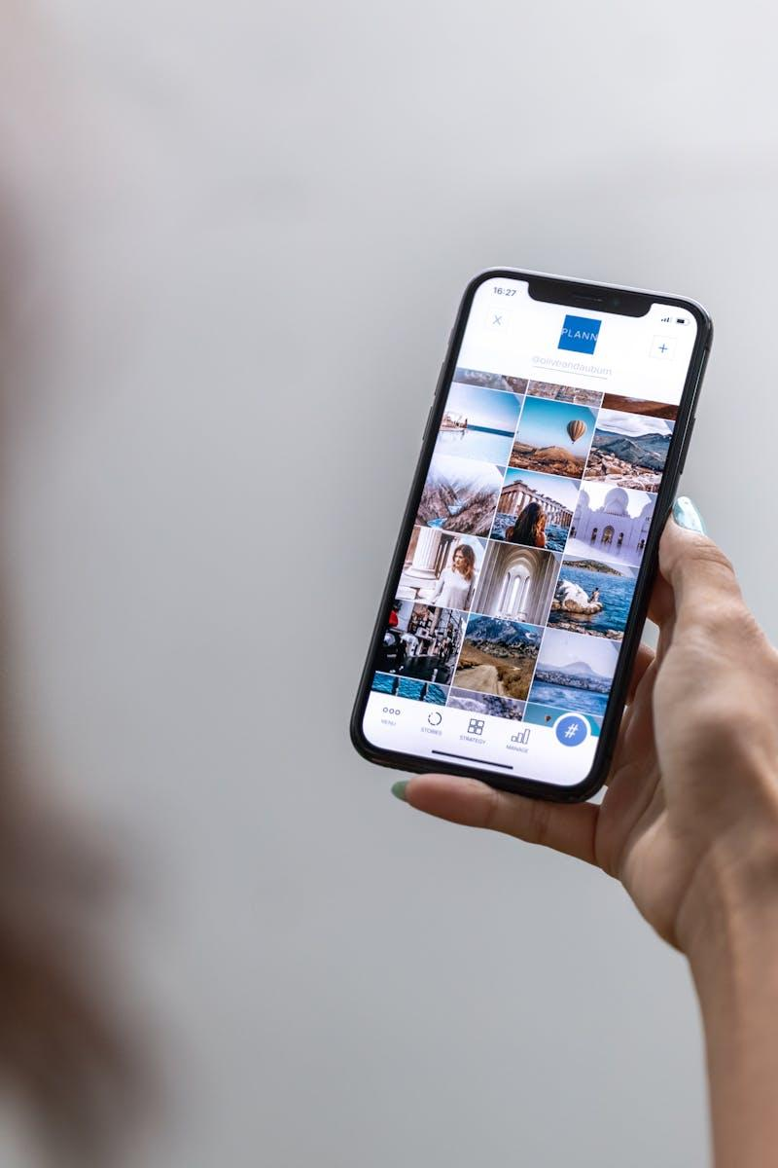
4
Key Features
App Highlights
User-friendly interface allowing easy navigation for both restaurants and NGOs to list and claim food.
NGO Authentication with NGO number to avoid fraud.
Real-time updates on food availability, donation status, and pick-up/Delivery schedules to streamline coordination.
Automated notifications and reminders to ensure timely communication and food collection.
Emergency Button to prioritise the need of food.
Data & graphical analytics to track donation trends and identify areas for process improvements and increased efficiency.

Slide 8

5
Impact
Community Benefits
Significantly reduces food waste by redirecting surplus food to those in need rather than letting it spoil.
Provides consistent and nutritious meals to underprivileged communities, enhancing their overall well-being.
Strengthens the bond between local businesses and community organizations, fostering a sense of shared responsibility.
Creates a sustainable system where food resources are utilized efficiently, benefiting both donors and recipients.

Slide 9
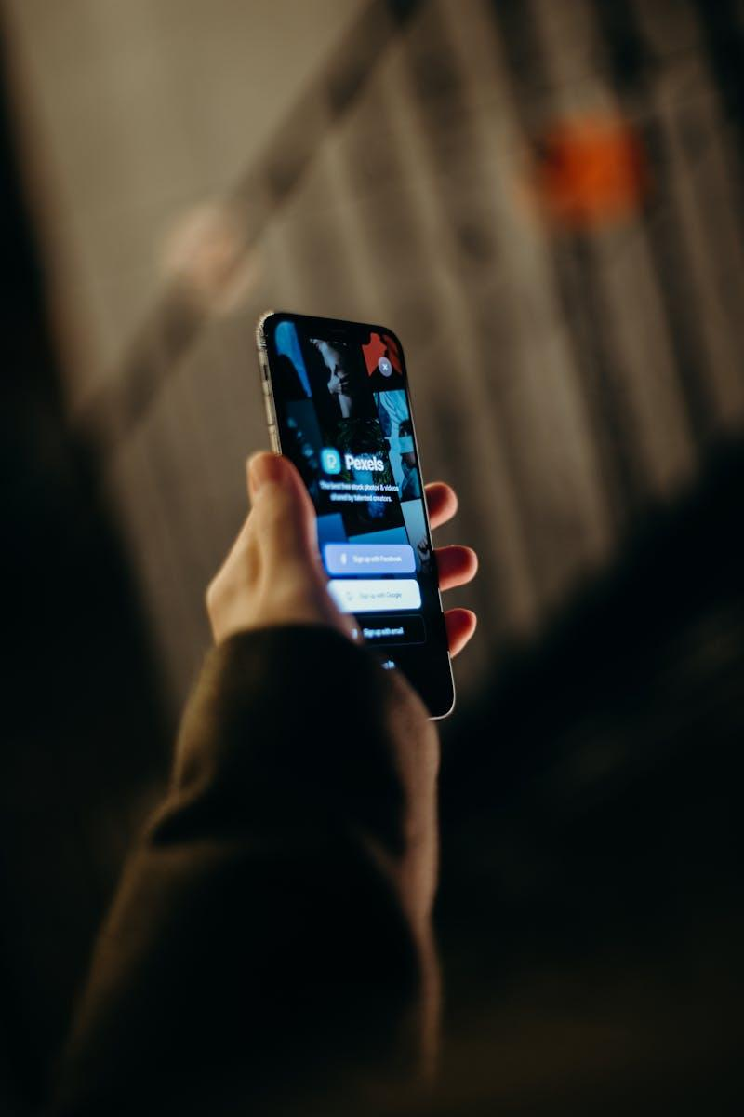
6
User Feedback
Testimonials
Restaurant owner: 'The app made it incredibly easy to donate our surplus food, helping the community and reducing waste.'
NGO coordinator: 'We now have a reliable source of food donations which allows us to feed more people consistently.'
Volunteer: 'It’s rewarding to see the direct impact of surplus food donations, helping those who really need it.'
End recipient: 'Thanks to the app, we receive nutritious meals daily, which has significantly improved our living conditions.'

Slide 10
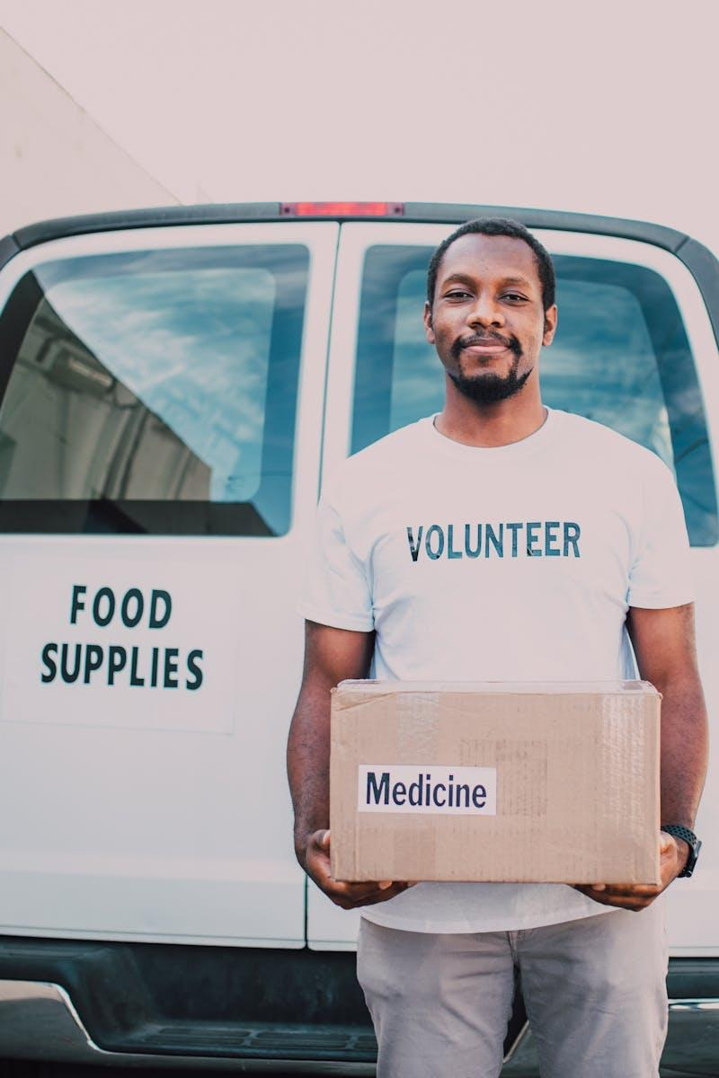
7
Challenges
Addressing Issues
Ensuring timely pick-up and transportation of donated food to avoid spoilage and inefficiencies via sealed package.
Engaging more restaurants and NGOs to join the platform for broader reach and impact.
Addressing dietary restrictions and preferences to ensure donated food meets health standards.
Maintaining the sustainability of the app through funding, partnerships, and continuous improvements.

Slide 11
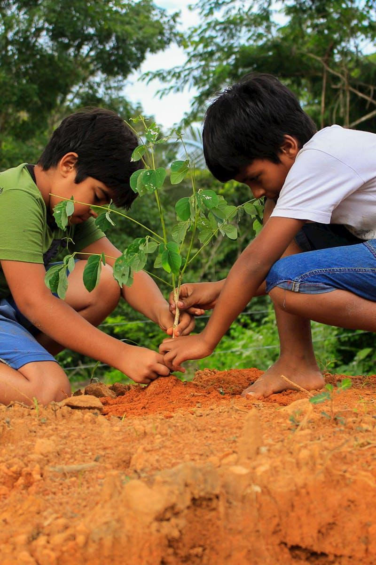
8
Future Plans
Expansion Goals
Scaling the app to new cities and regions, increasing the number of participating restaurants and NGOs.
Introducing more features like donation tracking, impact reporting, and volunteer coordination.
Building partnerships with large-scale food suppliers, grocery stores, and other potential donors.
Continuously improving user experience based on feedback and technological advancements.

Slide 12

9
Conclusion
Next Steps
The web app is a pivotal innovation addressing the twin issues of food waste and hunger in the community.
Maximizing engagement and collaboration can lead to a more significant and sustained impact on food distribution.
Encouraging more stakeholders to participate will help in scaling the initiative and reaching more people.
Together, we can create a system where surplus food finds its way to those in need, fostering a giving community.

Slide 13

10
Q & A
Thank you for your attention. We've covered a lot of ground today regarding our initiative to connect NGOs and restaurants for surplus food distribution. Now, we would like to address any questions you may have. Here are some common queries we've anticipated to help clarify our mission, operations, and the impact of our web app. Let's dive into the Q&A.

